Slide 1
ARE YOU AN
ENTREPRENUER?
Have you been starting and leading endeavors your whole life?
Have you started your own venture or significantly transformed
the operations of an existing institution based on your new ideas?
Have you ever been so possessed by an idea that you pursued it
even though everyone said it was crazy?
If your answer is “YES”
for all questions,
turn the page

Slide 2
CONNECT TO THE WORLD WITH
DASAN NETWORKS
Network Software Developer
Java Developer
Quality Assurance Engineer
DASAN Networks is hiring!

Slide 3
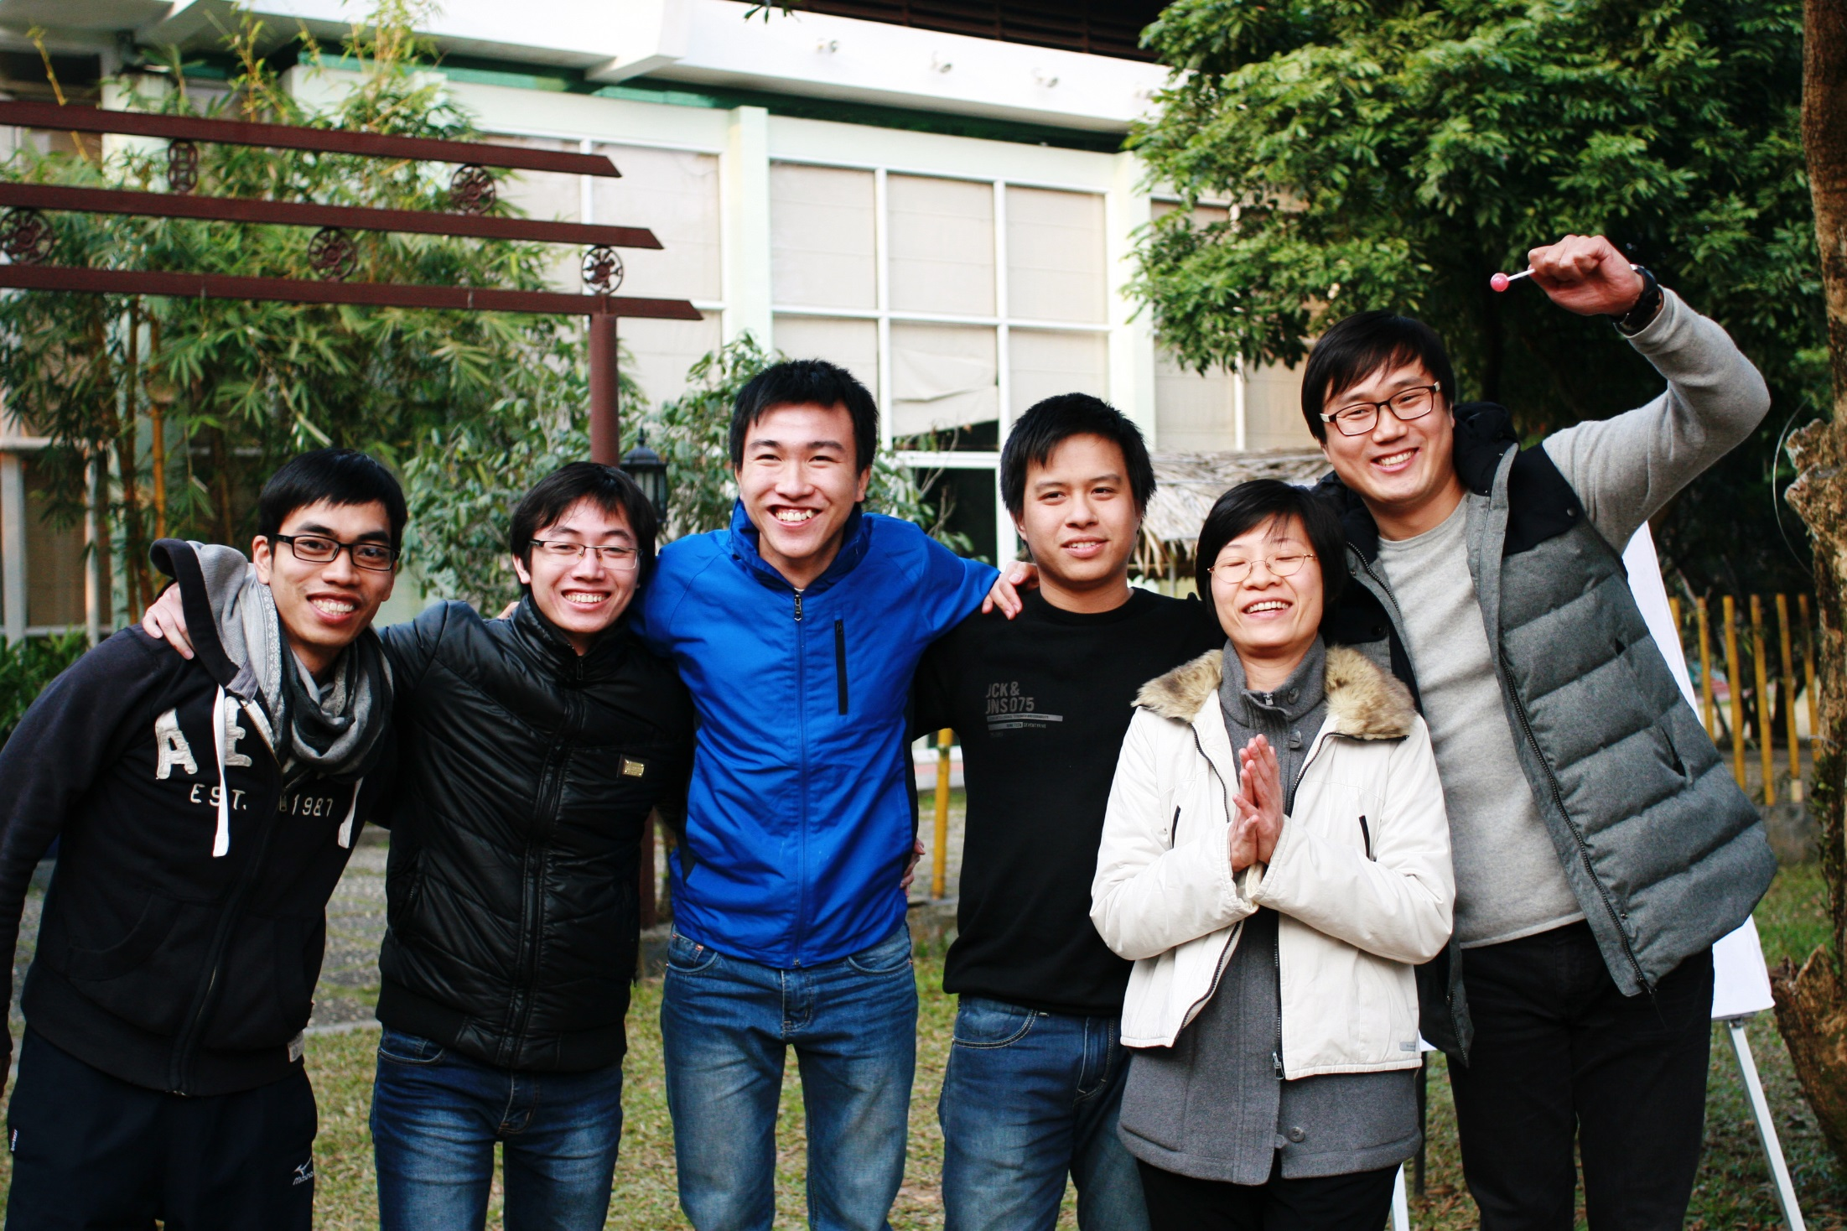
Meet Your Future Colleagues
http://www.dasannetworks.com

Slide 4
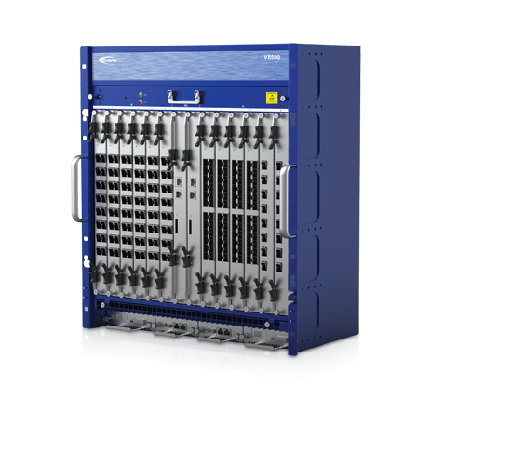
1 . NETWORK SOFTWARE DEVELOPER
DASAN Networks
is hiring!
We are developing advanced routers and switches using Linux Kernel and Network Protocols. And we are building our new enhanced platform at here, Hanoi research and development branch.
If you’re interested in network and have experiences in design, analysis, development using C language, Network Protocol, Broadband Network Design (Switch, Router, FTTx, …) , Network Maintenance, and Linux kernel.
Developing Network equipment on Enhance Platform and having programming skills as C language, analyze and design Networks Protocol Linux Kernel Programming.
Ability to design and analyze Networks Protocol, Broadband Network Design (Switch, Router, FTTx) , Network Maintenance.
Master Linux Device Driver Development
Master the internet protocols (L2, L3, Routing Protocols, Etc...)
Analyze, Design, Implement and document the new products or custom requirements.
Customize, bug fix, innovate our products.
Develop Linux base applications and kernel device drivers for Power PC and MIPs processor.
Working closely with customers running products and devices.
http://www.dasannetworks.com

Slide 5
2 . JAVA DEVELOPER
DASAN Networks
is hiring!
We are building software to support our Agile business management process. So we welcome both junior and senior Java developers to join with the following job descriptions.
Job duties:
Develop plugins and gadgets that extend the capability of JIRA
Enjoy flexible, and active environment and improve yourself continuously to become an Agile professional
Defines site objectives by analyzing user requirements; envisioning system features and functionality.
Designs and develops user interfaces to applications by setting expectations and features priorities throughout development life cycle; determining design methodologies and tool sets; completing programming using languages and software products; designing and conducting tests.
Recommends system solutions by comparing advantages and disadvantages of custom development and purchase alternatives.
Completes applications development by coordinating requirements, schedules, and activities; contributing to team meetings; troubleshooting development and production problems across multiple environments and operating platforms.
Updates job knowledge by researching new internet/intranet technologies and software products; participating in educational opportunities; reading professional publications; maintaining personal networks; participating in professional organizations.
Skills/Qualifications:
STRONG JAVA development skills and experience, such as: J2EE, Servlets, Hibernate, Maven, Spring,…
Web Programming Skills: HTML, XML, JSON, Javascript, CSS, Databases.
http://www.dasannetworks.com

Slide 6
3 . QUALITY ASSURANCE ENGINEER
DASAN Networks
is hiring!
We are equipping Vietnam network providers with high-speed, feature-rich, various network solutions , and exceptional customer services. And we are looking for skilled and active QAs.
Job duties:
Understand about Broadband Network Equipment such Switch, Router, GPON, EPON.
Defines, develops, and implements quality assurance practices and methodology, test plans, and test cases.
Hands on testing of server components, system interfaces and client components.
Develops new approaches to solve problems identified during quality assurance activities.
Communicates significant issues or developments identified during quality assurance activities and provides recommended process improvements to management.
Prepares and presents technical and program information to team members and management.
Coordinate the activities of QA Teams in the development of test plans, and test cases to meet individual project objectives.
Plans and conducts analysis, inspection, design, test, and/or integration to assure the quality for large and complex multi-tier applications.
Performs quality engineering reviews of design documentation for compliance with stated requirements.
Skills/Qualifications:
Degree in Computer Science, Technology or related field is required.
Complete understanding of the Software Development Lifecycle and QA’s role .
Solid understanding of TCP/IP and network protocols.
Must possess strong knowledge of QA methodology and deep experience in Testing.
http://www.dasannetworks.com

Slide 7
YOU WILL HAVE
Top Salary Great Environment Hottest Industry
Training courses: English, Network, Coding, Soft Skills…
Oversea business trips
Direct mentor by Korean experts
Attractive profit sharing/compensation based on working results
And many other benefits: Fitness, family hours, workshop, birthday,..
http://www.dasannetworks.com

Slide 8
We are
hiring!
BUILDING THE TEAM:
HIRING CRITERIA
1
2
3
4
5
ENTREPRENEURSHIP /INTRAPRENEURSHIP | UNDERSTANDING & BELIEF IN EVERYONE A CHANGEMAKER | SOCIAL & EMOTIONAL INTELLIGENCE | ETHICAL FIBER | SELF DEFINITION
Cannot come to rest in life until the new idea for society this person conceived and developed is the way things are routinely done. This requires a very long term commitment, constant listening and adjusting and relentless and realistic how-to thinking and passion for seeing their ideas come to life | Understands and believes the Everyone A Changemaker vision at a gut level. Has a broad and inquisitive intellect and a thinking pattern that connects the dots between historical trends and current social context. | Ability to work efficiently and respectfully in teams. Understands how individual, groups, and societies work and engage effectively in savvy, subtle, honest ways. | Exceptionally strong ethical behavior. Is self-reflective and has strong empathy skills. Trustworthy. | Assumes that changing the world in big ways and at least continental scale is what he or she will do in life. He/she naturally operates at this level and has developed appropriate skills and ways of thinking. He/she is not interested in small scale roles.
http://www.dasannetworks.com

Slide 9
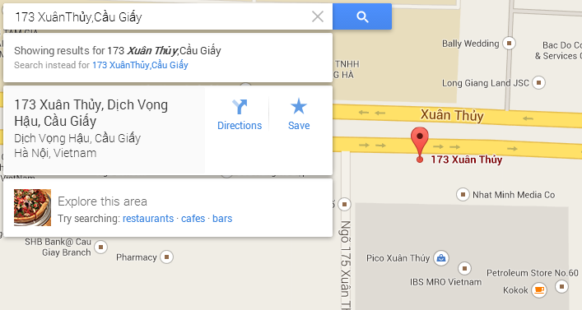
HOW TO APPLY
Mrs. Tuong Thu Hoai
Email: thuhoai.tuong@dasannetworks.com
Tel: (+84) 437 689 330
Mobile: 097 3694 592
http://www.dasannetworks.com

